Slide 1

Predicting Hit Songs with Machine Learning
BE-b, Group NO. 17
Prof. Priyadarshini Patil.
By:
- Ankush chimnani
- Anish DA Great
- Krishna Pathak
- Mukesh Singh

Slide 2
CONTENTS:
CONTENTS:
Objective
Literature Survey
Models Used
Dataset
Conclusion
Motivation
Application

Slide 3
Objective:
Some studies have tried to address the question whether or not it is possible to use machine learning techniques to predict hit songs. The purpose of this project is to further investigate this subject.
To be able to analyze music tracks, a data set is compiled based on data from Spotify’s API.
The data set consists of a number of audio features for each song. Afterwards, a number of machine learning algorithms is applied to this dataset.

Slide 4
MOTIVATION:
We wanted to work on a project that used multiple Machine Learning models so that we can have a better understanding of the different types of models and where to use them.
This project will allow us to explore the different types of machine learning models and compare them as per their accuracy. This also gives us a reason to understand the process needed to apply a machine learning model in real world scenarios.

Slide 5
Literature survey:
1
Herremans, D. & Bergmans, T.
Hit song prediction on early adopter data and audio features.
2
Yang, L.-C., Chou, S.-Y., Liu, J.-Y., Yang, Y.-H., & Chen, Y.-A
Revisiting the problem of audio-based hit song prediction using convolutional neural networks.
3
Dorien Herremansa, David Martens.
Dance hit songs prediction (JIMR 2014).

Slide 6
3
Holly Silk, Raul Santos-Rodriguez, Cedric Mesnage.
Data science for hit songs prediction (ISMIR 2016).
4
Vinitha S, Sweetlin S, Vinusha H and Sajini S.
Machine Learning Applied to Cervical Cancer Data (MECS 2019).
5
R Dhanaraj, B Logan.
Automatic hit songs prediction.

Slide 7

Machine Learning techniques used:
Logistic Regression
Naive Bayes
Support Vector Machine
Random Forest

Slide 8
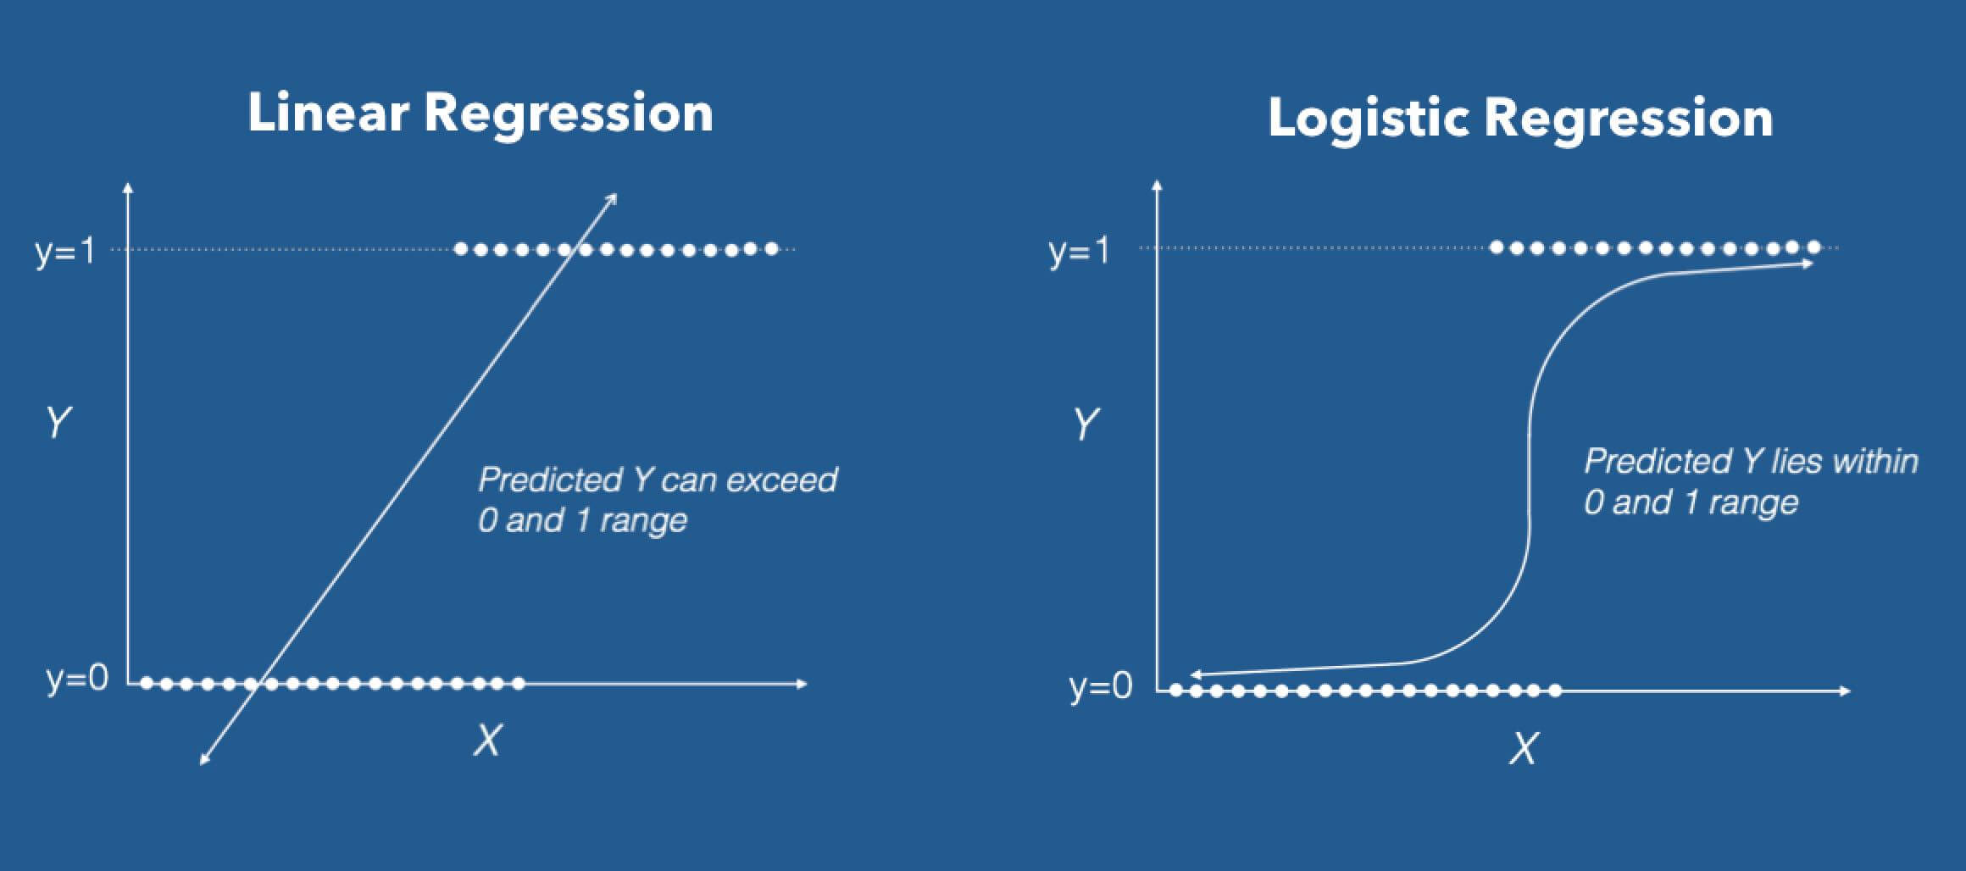
Logistic Regression
Logistic regression is the appropriate regression analysis to conduct when the dependent variable is dichotomous (binary). Like all regression analyses, the logistic regression is a predictive analysis. Logistic regression is used to describe data and to explain the relationship between one dependent binary variable and one or more nominal, ordinal, interval or ratio-level independent variables.

Slide 9
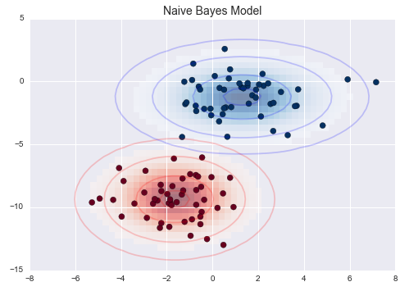
Gaussian Naive Bayes
A Gaussian Naive Bayes algorithm is a special type of NB algorithm. It's specifically used when the features have continuous values. It's also assumed that all the features are following a gaussian distribution i.e, normal distribution.

Slide 10
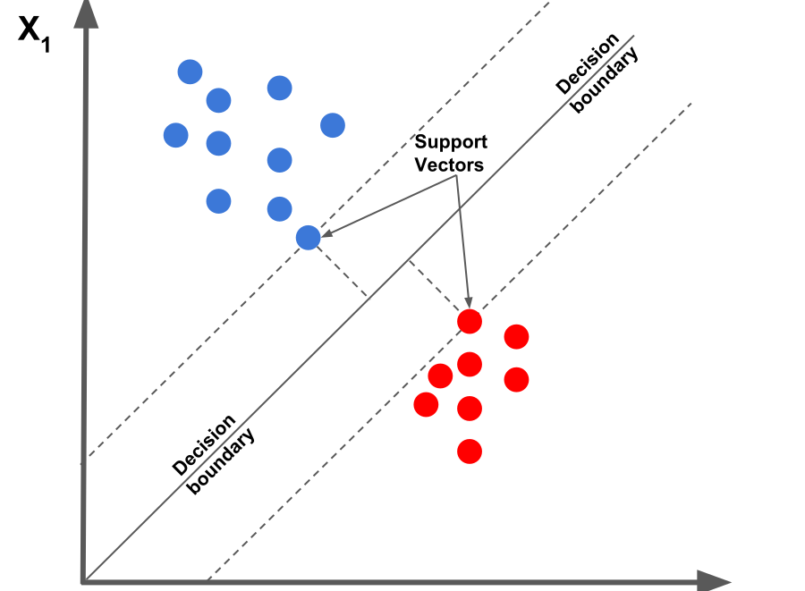
Support Vector Machine
A Support Vector Machine (SVM) is a discriminative classifier formally defined by a separating hyperplane. In other words, given labeled training data (supervised learning), the algorithm outputs an optimal hyperplane which categorizes new examples. In two dimensional space this hyperplane is a line dividing a plane in two parts where in each class lay in either side.

Slide 11
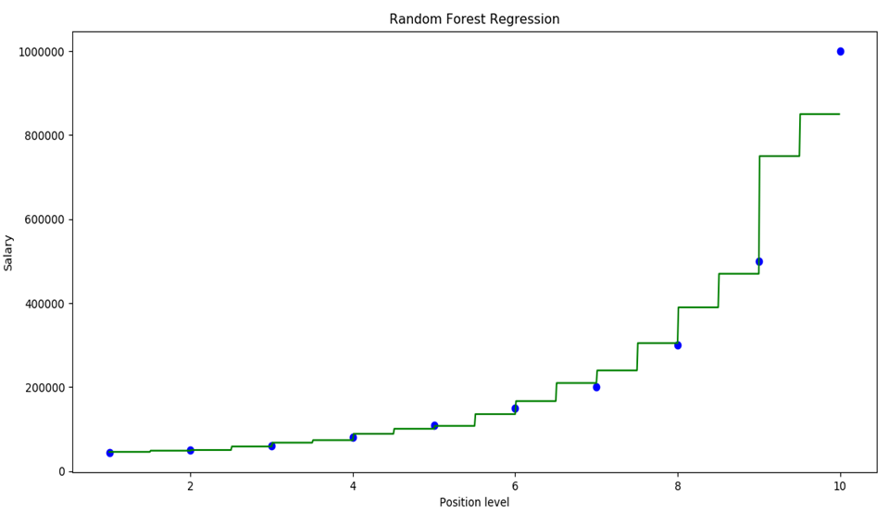
Random Forest
Random Forest is an ensemble tree-based learning algorithm. The Random Forest Classifier is a set of decision trees from randomly selected subset of training set. It aggregates the votes from different decision trees to decide the final class of the test object.

Slide 12

Other techniques that could be used:
KNN
Artificial Intelligence
Deep Learning

Slide 13
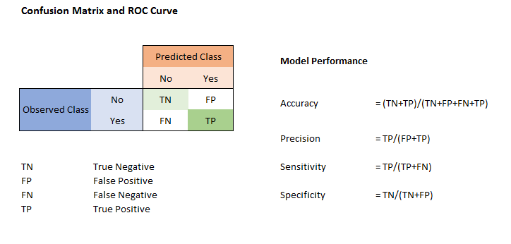
Confusion matrix:

Slide 14
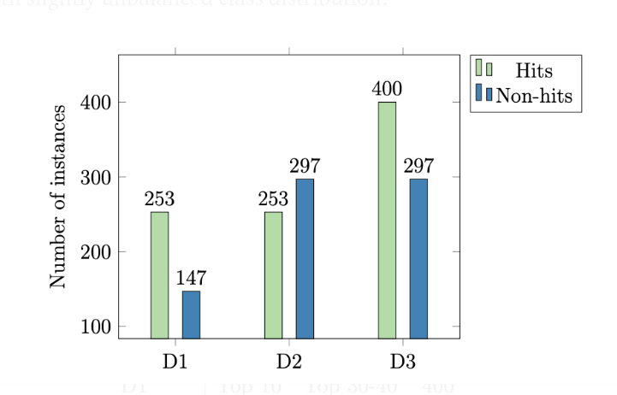
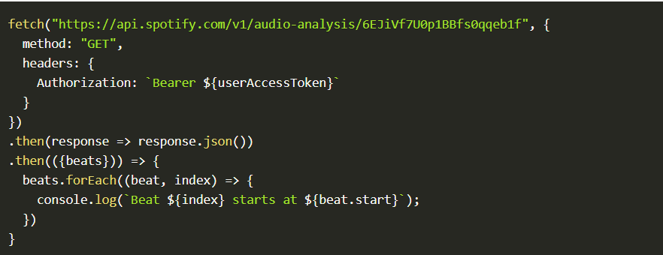
Dataset:
Spotify API:
The dataset of audio features used in this project is fetched from Spotify’s Web API.
The hit listings were collected from two sources: Billboard (BB) and the Original Charts Company (OCC). The table below shows the amount of hits collected.
This nifty API allows us to get a number of audio features, based only on the artist name and song title.
In order to be able to do hit prediction, we first need a dataset of hit / non-hit songs. While there is no shortage of hit-lists, it is quite another thing to find non-hit lists. Therefore, we decided to classify between high and low ranked songs on the hit listings.

Slide 15
Audio features to be analyzed:
Duration
Tempo
Loudness
Timbre
Energy
Danceability

Slide 16
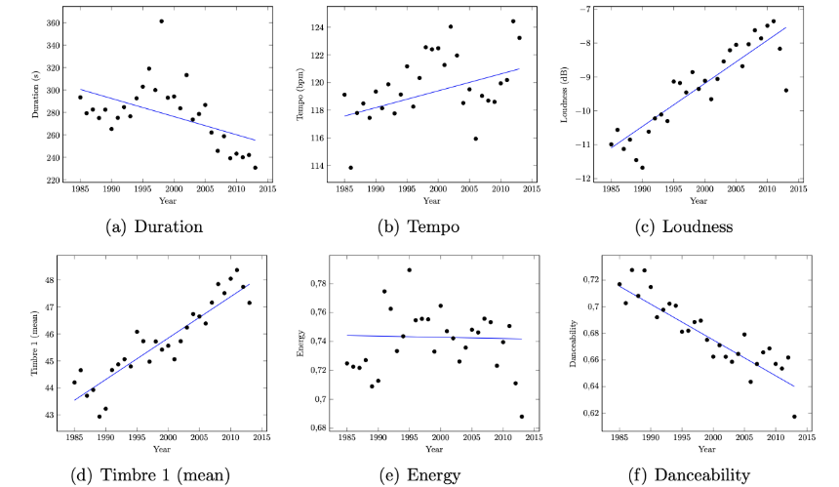
The audio features of hit songs differ over the decades. We think this is an appropriate thing to keep in mind when we are selecting what data to be used for model building. To visualize this, lets observe the diagrams which shows how the different features for song tracks has changed over time. The data is based on the Billboard Hot 100 tracks from 1980 until today, and the audio features are fetched from the Spotify API.

Slide 17
Method:
Fetch data from Spotify
Preprocess data
Build different models
Compare different results
Predictions and Accuracy
Choose the best model
Evaluation of models

Slide 18
Applications:
Music industries
Composers
Musicians
Hit rate of other products
Mobile Phone
Other interested parties
Movie producers
Music enthusiasts
Movies

Slide 19
Have a better understanding of all the machine learning models used.
1
At least one of the models created should have a prediction rate of more than 0.5.
2
Our models should work on real world problems, with a possibility of expansion into other fields.
3
What we expect to Achieve:

Slide 20

Thank You

